Slide 1
Logistic Regression
Itay Hazan

Slide 2












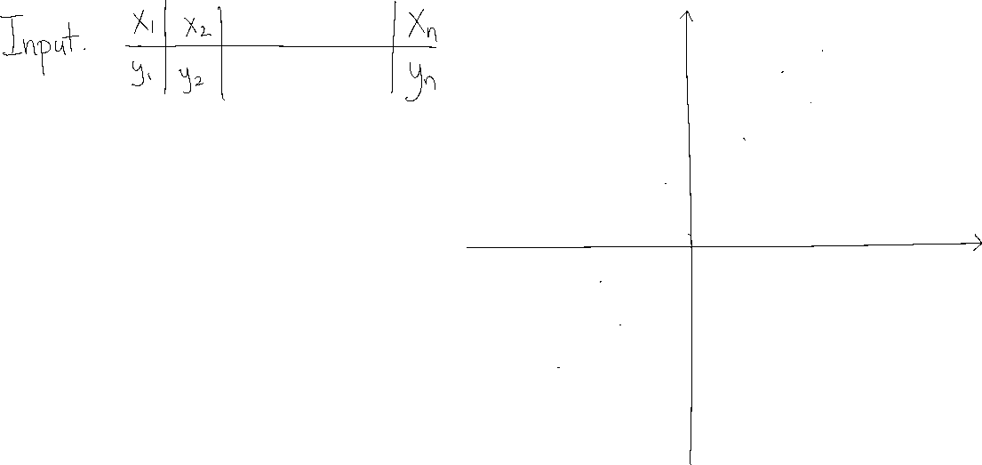







Reminder: Linear Regression

Slide 3

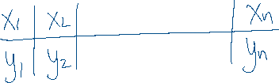


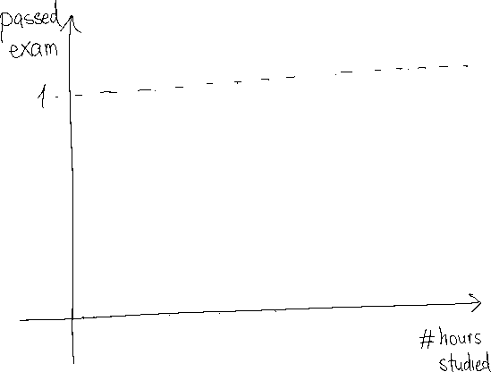
Binary Logistic Regression

Slide 4











Binary Logistic Regression

Slide 5


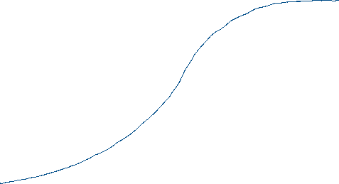




Binary Logistic Regression

Slide 6
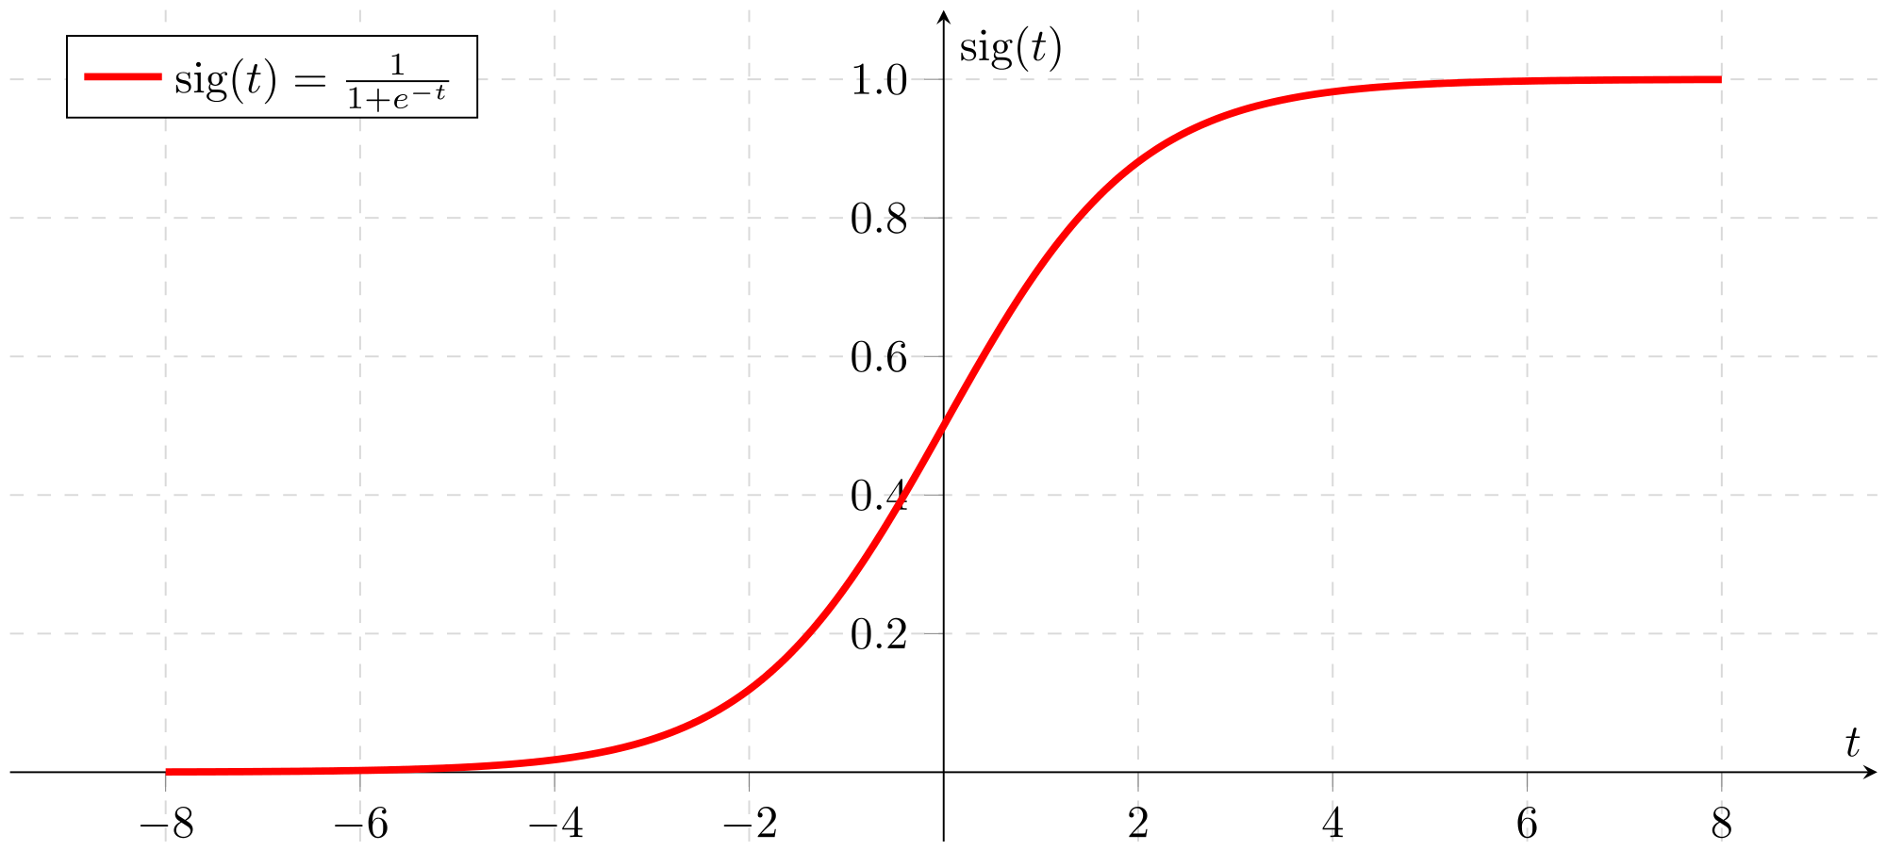
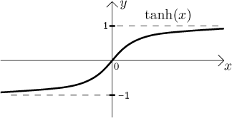






Binary Logistic Regression

Slide 7

















Binary Logistic Regression

Slide 8




Binary Logistic Regression

Slide 9









Binary Logistic Regression

Slide 10



Binary Logistic Regression

Slide 11




Binary Logistic Regression

Slide 12







Binary Logistic Regression

Slide 13







Binary Logistic Regression

Slide 14





Binary Logistic Regression

Slide 15





Binary Logistic Regression

Slide 16












Binary Logistic Regression

Slide 17
Multivariate Binary Logistic Regression

Slide 18












Multivariate Binary Logistic Regression

Slide 19





Multivariate Binary Logistic Regression

Slide 20



Multivariate Binary Logistic Regression

Slide 21


Multivariate Binary Logistic Regression

Slide 22
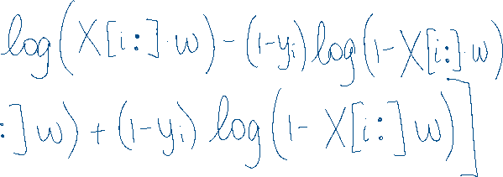

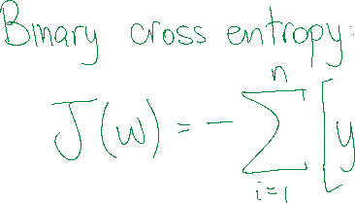

Multivariate Binary Logistic Regression

Slide 23








Multivariate Binary Logistic Regression

Slide 24








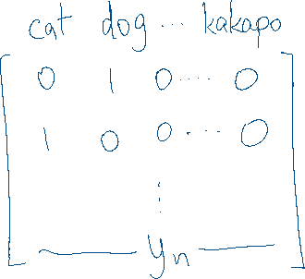








Multivariate Categorical Logistic Regression

Slide 25




Multivariate Categorical Logistic Regression

Slide 26

Multivariate Categorical Logistic Regression

Slide 27

Multivariate Categorical Logistic Regression

Slide 28

Multivariate Categorical Logistic Regression

Slide 29





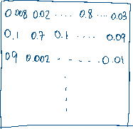

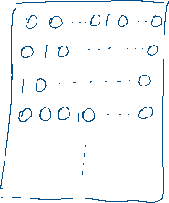
Multivariate Categorical Logistic Regression

Slide 30
Multivariate Categorical Logistic Regression

Slide 31
Multivariate Categorical Logistic Regression

Slide 32





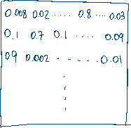

Multivariate Categorical Logistic Regression

Slide 33






Multivariate Categorical Logistic Regression

